Slide 1
Lab Oriented Project
on
Employee Management System
(Course Code: CS253)
Presented By
Ankesh Kumar (2211985007)
Bhavneesh Sharma (2211985015)
Tarun Rana (2211985052)
Ankit Thakur (2211985008)

Slide 2
Content :-
Objective
Survey
Problem Statement
Methodology
Features
Sequence Diagram
Tech Stack
Conclusion

Slide 3
Objective
Our primary objective is to deliver a comprehensive Employee Management System that simplifies HR administrative tasks while simultaneously empowering employees with greater control and transparency over their work lives.
Automate HR Processes: Reduce manual effort and human error.
Enhance Employee Empowerment: Provide self-service tools for autonomy.
Improve Data Accessibility: Ensure secure, on-demand access to information.

Slide 4
Survey
We identified key pain points through research and stakeholder interviews. HR teams reported spending excessive time on manual, repetitive tasks like leave management and onboarding. Employees expressed frustration with a lack of transparency into their leave balances, payroll details, and approval statuses, leading to decreased satisfaction and increased inquiries to HR.

Slide 5
Problem Statement
Organizations struggle with outdated, inefficient HR systems that lead to:
Manual Processes: Time-consuming and error-prone tasks like leave management and onboarding.
Lack of Transparency: Employees lack visibility into their data, causing distrust and frustration.
Fragmented Data: Employee records are scattered, hindering reporting and decision-making.
Inefficient Workflows: Disjointed processes for approvals and department management.
Our system directly tackles these challenges to transform HR operations.

Slide 6
Methodology
Identified key HR and employee pain points through analysis.
Planned a modular system architecture, database schema, and user flows.
Built frontend and backend with React.js, Node.js, and PostgreSQL.
Ensured functionality, security, and performance through rigorous testing.
Hosted on scalable cloud platforms (AWS/Azure) for high availability.
Regular iterations based on user feedback for continuous improvement.
Documented the development process for maintenance and future enhancements.

Slide 7
Features
For Employees:
Self-service leave application with balance visibility
Secure access to personal data and payroll information
Instant notifications for approvals and updates
For Employers/HR:
Effortless employee onboarding and profile management
Streamlined leave and payroll approval workflows
Dynamic department creation and assignment
Comprehensive reporting and data accessibility

Slide 8
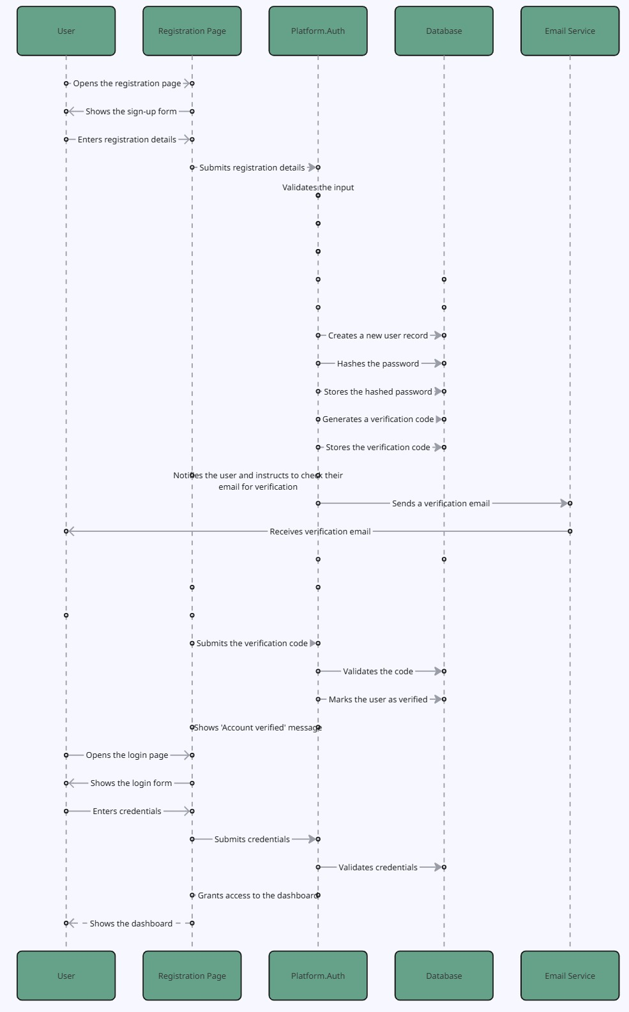

Slide 10
Tech Stack
Frontend: React.js
Backend: Node.js with Express.js
Database: MongoDB
Styling: CSS Modules ,Tailwind Css
Authentication: JWT
Deployment: Vercel
Tools: Git, GitHub, VS Code

Slide 11
Conclusion
Our Employee Management System offers a modern, comprehensive solution to:
Streamline HR processes and reduce manual workload.
Empower employees with self-service tools and transparency.
Provide employers with efficient control over workforce management.
"This system is designed to transform HR from a cost center into a strategic partner, fostering a more productive and engaged workforce."
Invest in a system that ensures compliance, efficiency, and a positive employee experience.

Slide 12
Thank You

